Slide 1
Inter-Process Communication Using Pipe and Message Queue

Slide 2
OBJECTIVE
To implement IPC using Pipe.
To implement IPC using Message Queue.
To evaluate data exchange between processes.

Slide 3
Inter-Process Communication (IPC)
Inter-Process Communication (IPC) allows processes to communicate and share data.
IPC is required when: • Multiple processes need to cooperate • Data sharing is required • Synchronization is needed
Common IPC mechanisms include: • Pipe • Message Queue • Shared Memory • Semaphore
This project implements Pipe and Message Queue.

Slide 4
IPC USING PIPE
Pipe is a unidirectional communication mechanism.
Characteristics:
• Used between related processes (parent-child) • Created using pipe() system call • Data flows in one direction • Simple and efficient communication

Slide 5

PIPE PROBLEM STATEMENT
Evaluate the expression:√(b² − 4ac)
Process Division:
Child Process
Calculates $\left(b^{2}−4ac\right)$
Sends the result through pipe
Parent Process
Receives the result
Calculates the square root
Displays the output

Slide 6
PIPE ALGORITHM AND PIPE SYSTEM CALLS USED
ALGORITHM :
Create pipe using pipe().
Create child process using fork().
Child computes (b² − 4ac).
Child sends result using write().
Parent reads value using read().
Parent calculates square root using sqrt().
Display result.
SYSTEM CALLS USED: pipe() – Creates pipe fork()– Creates child process read() – Reads from pipe write() – Writes to pipe

Slide 7
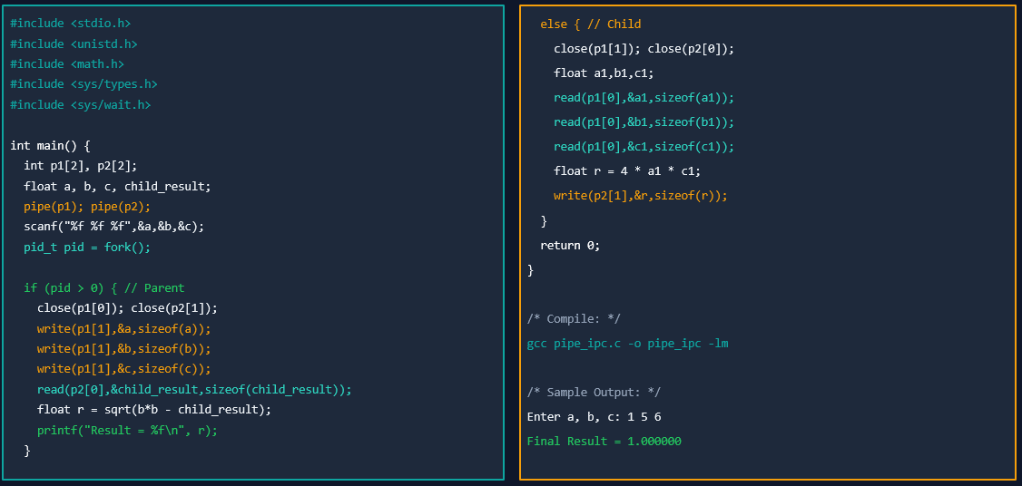
PROGRAM

Slide 8
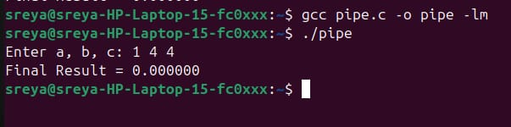
OUTPUT

Slide 9
IPC USING MESSAGE QUEUE
Message Queue allows communication using structured messages.
Characteristics:
• Supports bidirectional communication • Messages stored in kernel • Processes communicate using message types • More flexible than pipe

Slide 10
MESSAGE QUEUE PROBLEM STATEMENT
First process sends a string.
Second process reverses the string.
Second process sends reversed string back.
First process compares strings.
Displays whether the string is a palindrome or not.

Slide 11
MESSAGE QUEUE ALGORITHM AND SYSTEM CALLS USED
ALGORITHM:
Create message queue using msgget().
First process sends string using msgsnd().
Second process receives string using msgrcv().
Reverse the string.
Send reversed string back.
First process compares original and reversed strings.
Print result.
SYSTEM CALLS USED: • msgget() – Creates message queue • msgsnd() – Sends message • msgrcv() – Receives message • msgctl() – Deletes message queue

Slide 12
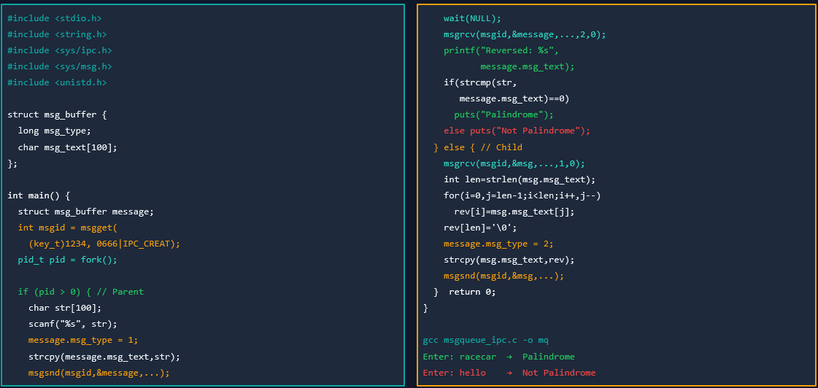
PROGRAM

Slide 13

OUTPUT

Slide 14
COMPARISON
FEATURE | PIPE | MESSAGE QUEUE
Communication | One-way | Two-way
Data Type | Byte stream | Structured message
Usage | Parent-Child | Any processes
Complexity | Simple | Moderate

Slide 15
CONCLUSION
• IPC enables communication between processes. • Pipe provides simple one-way communication. • Message Queue allows structured two-way communication. • Both mechanisms were successfully implemented in C.

Slide 16
THANK YOU

